Slide 1


EMPLOYEE DATA ANALYSIS
STUDEN NAME : AFRINBANU A
REGISTER NO : 312206301
DEPARTMENT : BCOM(A&F)
COLLEGE NAME: SSKV COLLEGE OF ATRS AND SCIENCE FOR WOMEN

Slide 2




OUR
PROJECT TITLE
Employee performance analysis

Slide 3
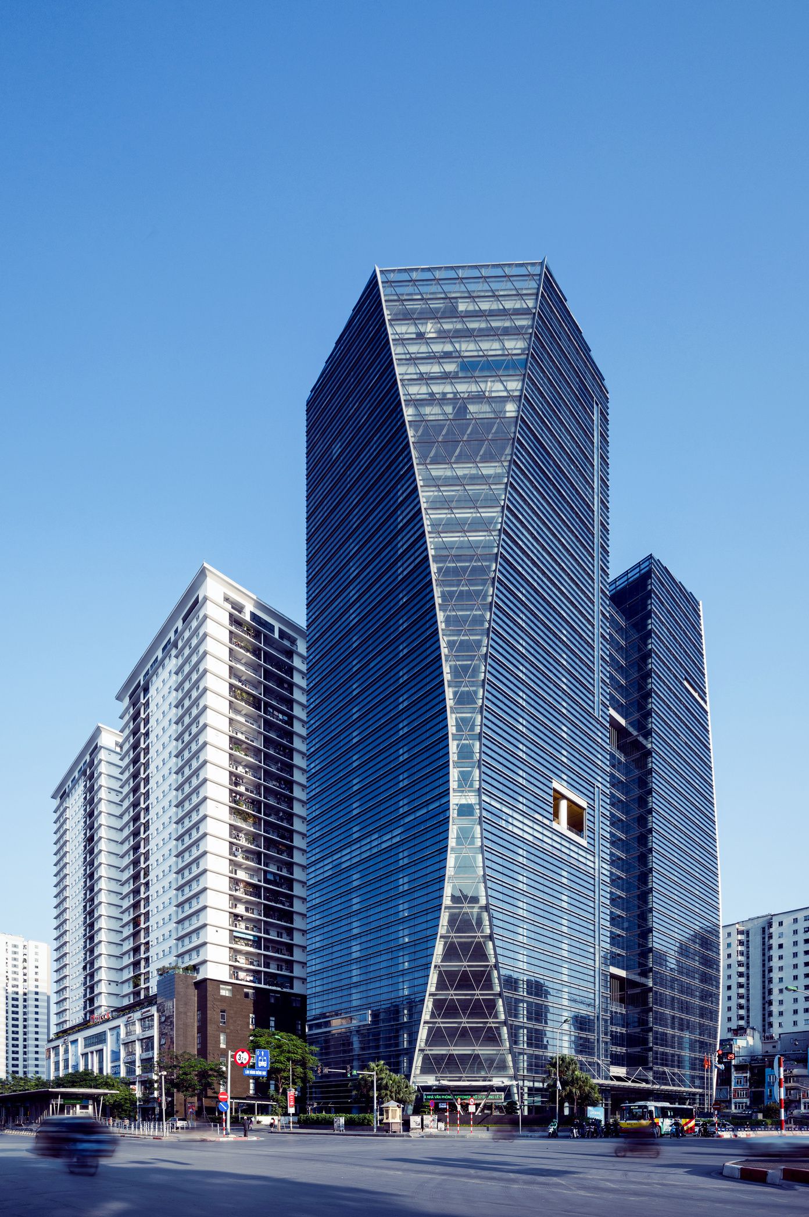
OUR
AGENDA
Problem Statement
Project Overview
End Users
Our Solution and Proposition
Dataset Description
Modelling Approach
Results and Discussion
Conclusion

Slide 4


PROBLEM STATEMENT
IDENTIFICATION OF PROBLEM OF AREA
PROVIDING FEEDBACK
PLANNING FOR CARRER DEVELOPMENT
INCREASE PRODUCTIVITY
IMPROVE COMMUNICATION

Slide 5

PROJECT OVERVIEW
Employee performance evaluations provide a dedicated time for managers to focus on individual performance and growth and development opportunities. This is an ideal time for employees to discuss their salary, career goals and learn what they need to do to achieve those goals

Slide 6
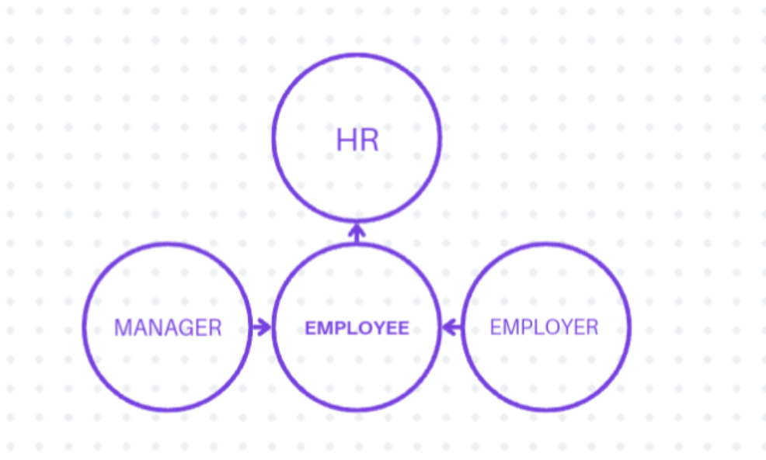
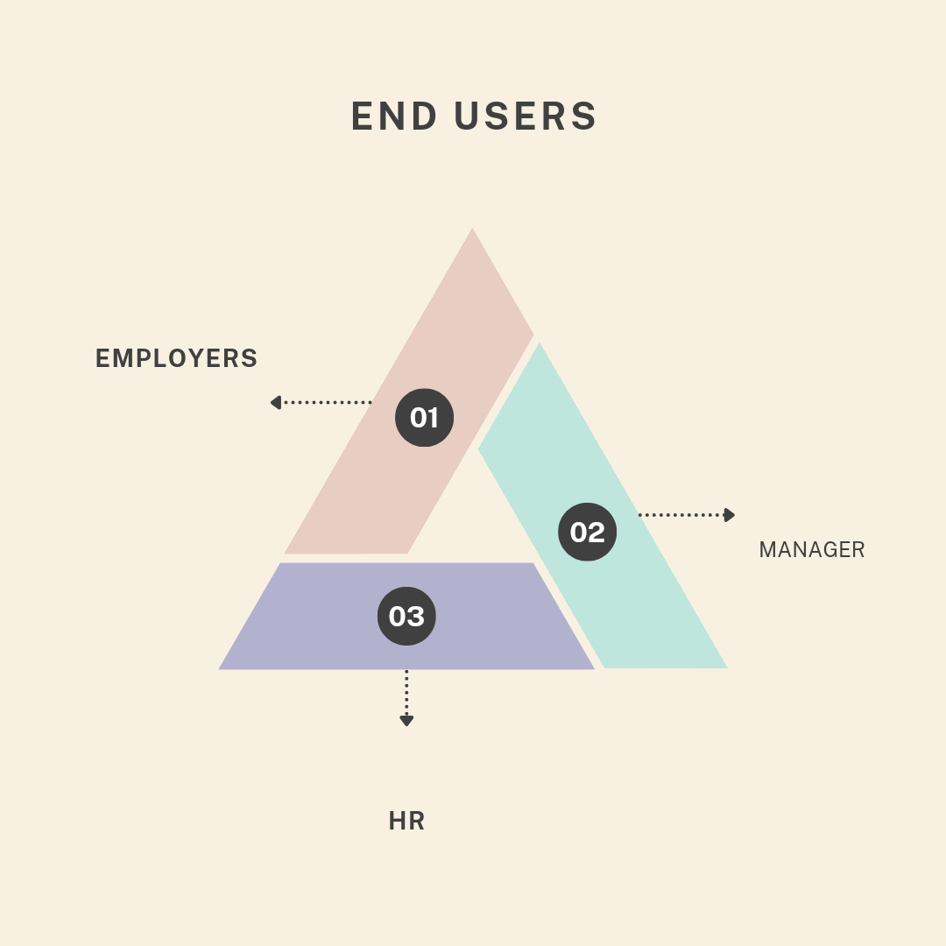
END USER
MANAGER
EMPLOYER
HR

Slide 7
Name:
Address:
Work number:
Contact number:
Employee ID:
Department:
Supervisor:
Work location Email address Work number Start date Salary:
DATA DESCRIPTION
This dataset contains information about employees in a company, including their educational backgrounds, work history, demographics, and employment-related factors. It has been anonymized to protect privacy while still providing valuable insights into the workforce.

Slide 8
THE WOW IN OUR SOLUTION
=IFS(Z2>=5,"VERY HIGH",Z2>=4,"HIGH",Z2>=3,"MEDIUM",TRUE,"LOW"

Slide 9

OUR SOLUTIONS AND VALUE
OF PROPOTION
Benefits
Vacation time, health insurance, pension options, and other non-monetary benefits
Career development
Training, mentorship programs, promotions, and other opportunities for growth
Work environment
A positive work culture with a healthy work-life balance, recognition, and autonomy
Sense of purpose
A clear sense of purpose for the organization and how it aligns with employees' desire to improve the world
Connection and community
A sense of belonging and social relationships where employees are valued and appreciated for who they are

Slide 10
MODELLING
Create a Data Entry Sheet:
Headers: Employee ID, Name, Department, Date, Statement Details, Approval Status, Comments.
Example Layout:
Employee ID Name Department Date Statement Details Approval Status Comments
001 John Smith HR 2024-09-01 [Text] Pending
Set Up Data Validation:
Approval Status: Use a drop-down list for statuses (Pending, Approved, Rejected).
Create a Summary:
Use basic formulas to count statements by status or department. For example:
=COUNTIF(F:F, "Pending") to count pending statements.
Review Process:
Filter data by status to review pending statements or sort by date for prioritization.
This simple setup helps you track and manage employee statements
fectively
. Pivot Chart:
Create a bar chart showing the count of statements by department and approval statu s.

Slide 11
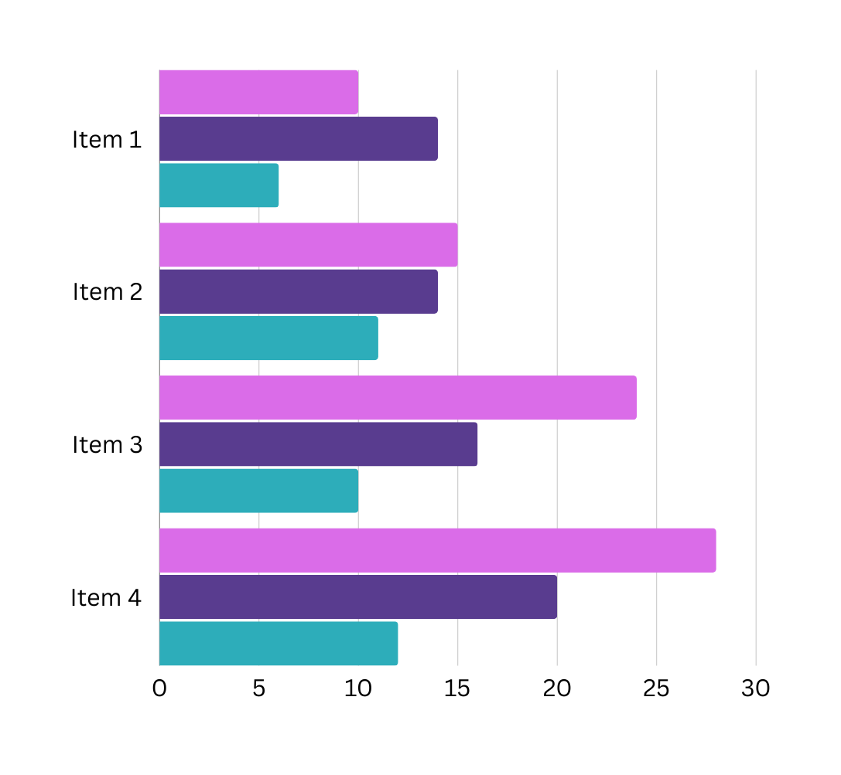
CHART OF
THIS YEAR

Slide 12
CONCLUSION
Employee performance evaluations provide a dedicated time for managers to focus on individual performance and growth and development opportunities. This is an ieal time for employees to discuss their salary, career goals and learn what they need to do to achieve those goals.

Slide 13

THANK YOU

